Slide 1
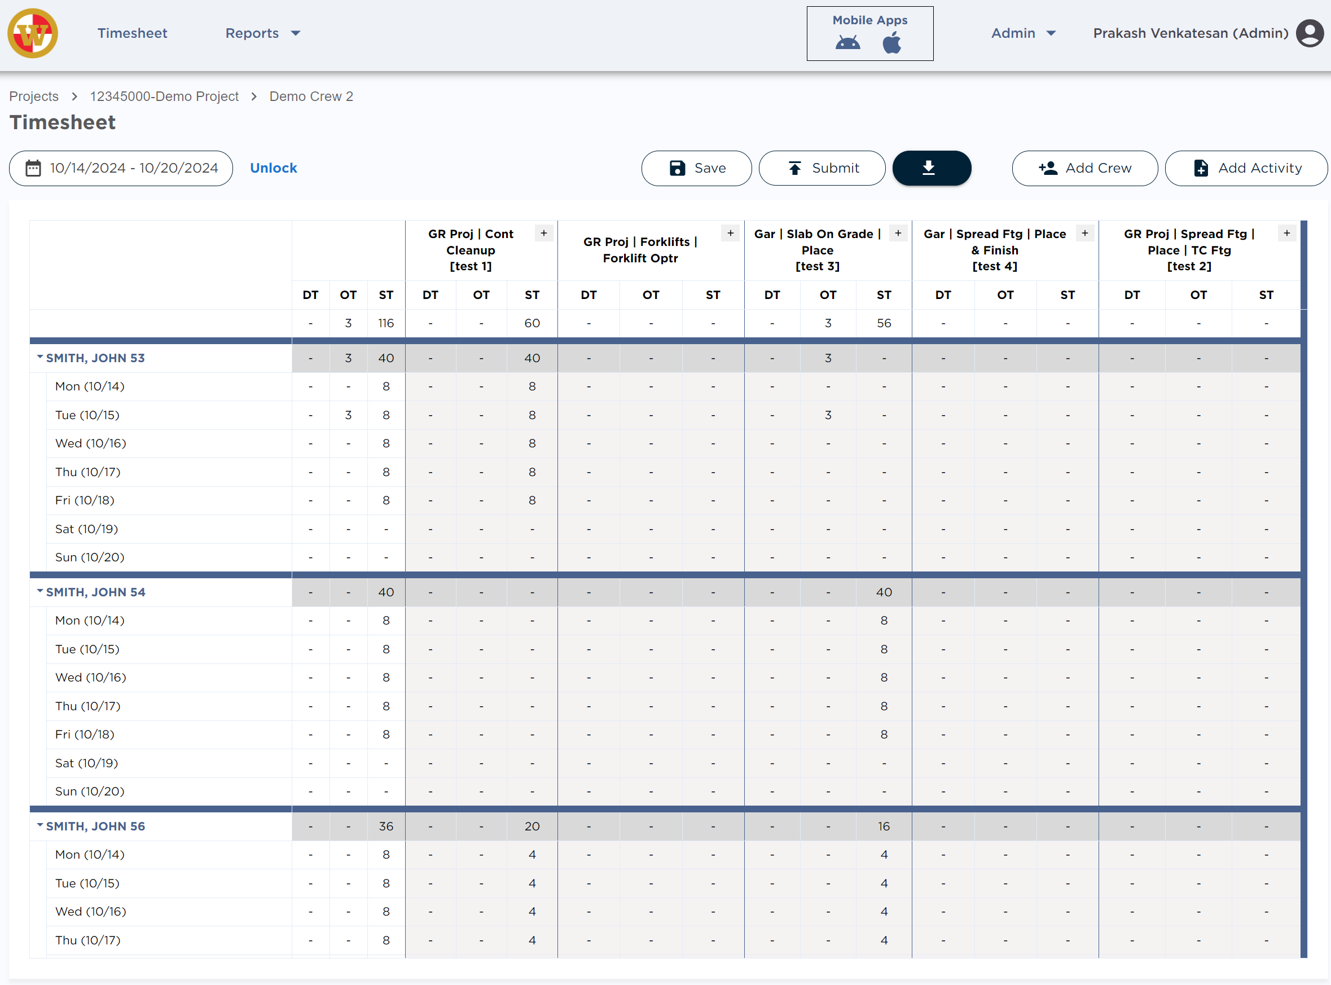

Howard S. Wright – Time Management Tool
Business Need
HSWC was managing time entry, estimate management, and other project management tasks using Excel & complex VBA customizations. This approach has become unsustainable, creating a significant manual burden resulting in a suboptimal user experience and integration inefficiency. Additionally, data is dispersed across multiple sheets, leading to errors in lookups and calculations. HSWC sought Affirma’s help to modernize its time tracking & project management process.
What We Did
Affirma, designed and developed a custom project management system from the ground up, leveraging Microsoft Azure Cloud technology. The development process involved several discovery sessions understanding the nuance business complexity in tracking time and how those are used to calculate project profitability.
Customized project and resource management features
Pivot style matrix for time entry by supervisors
Reporting to track project budget, actuals, projected & forecasted profits/loss
Integration with existing systems for seamless data flow and consistency
App for iPhone & Android users to record time entry in field
Super User-friendly UI/UX designed for ease of use and efficiency
Results
High data accuracy and no manual procedures
Better visibility into Budget vs Actual Project costs
Enhanced forecasting accuracy and project management capabilities
Increased user adoption and satisfaction from intuitive design and usability of the tool

Slide 2
